Slide 1
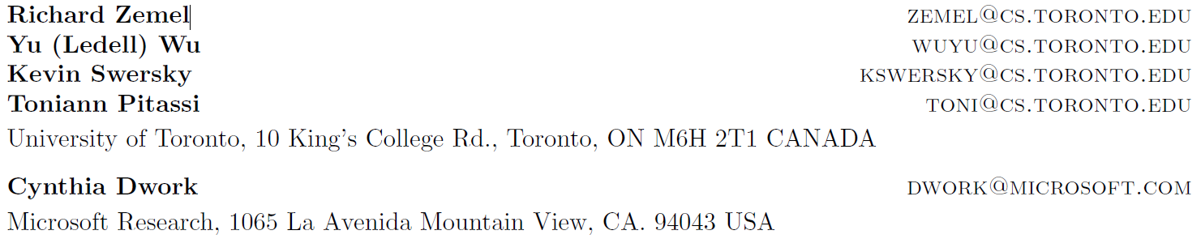
Learning Fair Representations
Proceedings of the 30th International Conference on Machine Learning, Atlanta, Georgia, USA, 2013. JMLR: W&CP volume 28.

Slide 2
Systems trained to make decisions (classification task) based on historical data will naturally inherit the past biases.
Example: A system to automatically screen applicants’ CV, leant from history HRs’ data.
Attempt to make the automated decision-maker blind to some attributes? Many attributes may be correlated with the protected one (gender, age).
Example: Assume that in history, gender may cause biases. However, simply ignoring ‘Gender’ feature is not enough, which can still be learnt from other features like ‘Name’, etc.

Slide 3
Group fairness, also known as statistical parity, ensures that the overall proportion of members in a protected group receiving positive (negative) classification are identical to the proportion of the population as a whole.
Example: # of female applicants/ # of male applicants = # of female interviewees / # of male interviewees, protected feature: Gender
In employment while maintaining statistical parity among candidates interviewed by deliberately choosing unqualified members of the protected group to be interviewed in the expectation that they will fail.
Example: selected unqualified protected candidates (female applicants) to interview, and actually in the further classification, the bias still exists.
Individual fairness, which means similar data points should be treated similar.

Slide 4
Method: Encode an intermediate representation.
Two competing goals:
the intermediate representation should encode the data as well as possible;
(ii) the encoded representation is sanitized in the sense that it should be blind to whether or not the individual is from the protected group.

Slide 5
Main idea
To map each individual, represented as a data point in a given input space, to a probability distribution in a new representation space.
The aim of this new representation is to lose any information that can identify whether the person belongs to the protected subgroup, while retaining as much other information as possible.
Formulate this new representation in terms of a probabilistic mapping to a set of prototypes (new encoded representation with same dimension as original feature space).

Slide 6
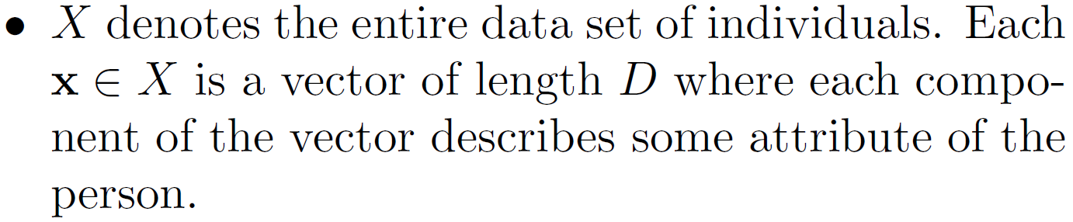
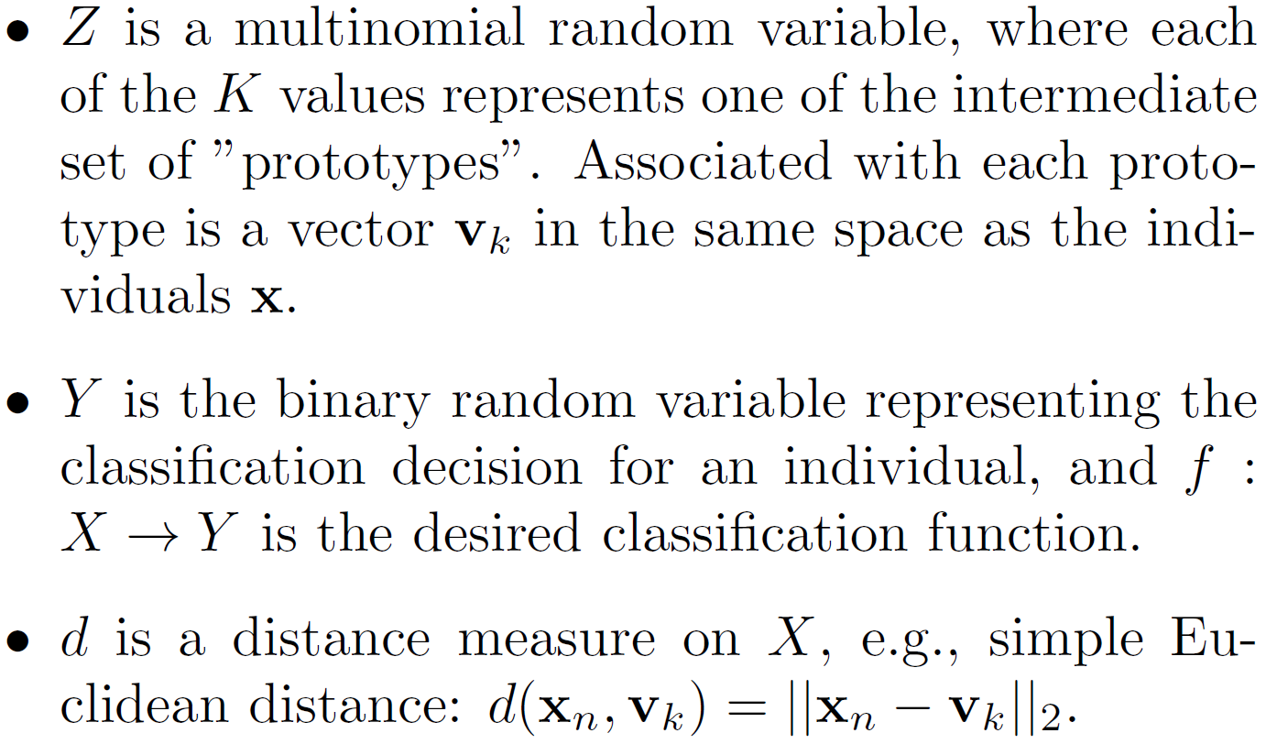
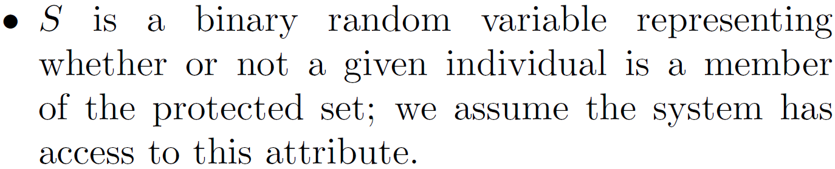
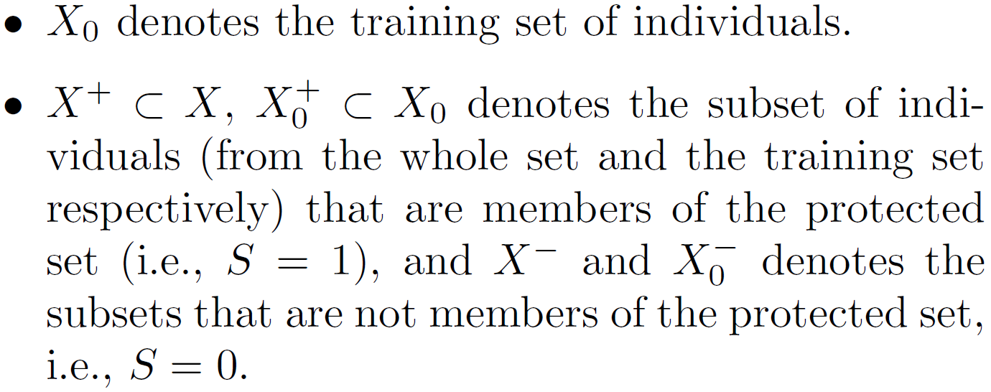
Notation

Slide 7
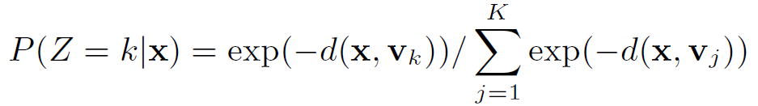
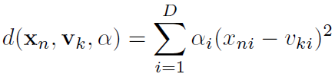
Group fairness:
Use softmax:
Parameters to learn
Parameters to learn, where i means the ith feature
To allow different input features to have different levels of impact, we introduce individual weight parameters for each feature dimension $α_{i}$
The model is thus defined as a discriminative clustering model, where the prototypes act as the clusters.

Slide 8
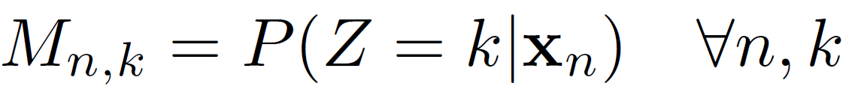

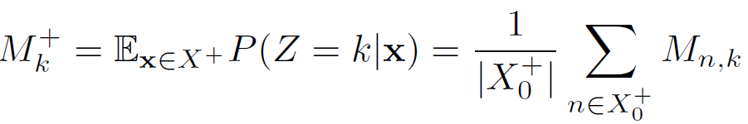

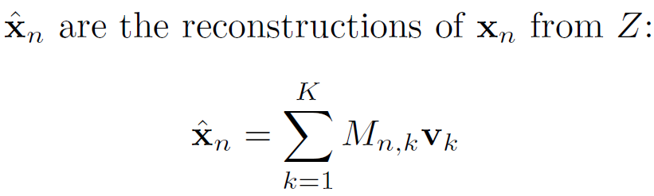
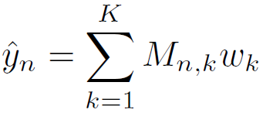

Define:
as the probability that $x_{n}$ maps to $v_{k}$.
To achieve statistical parity, we want to ensure:
Where:
Parameters to learn

Slide 9

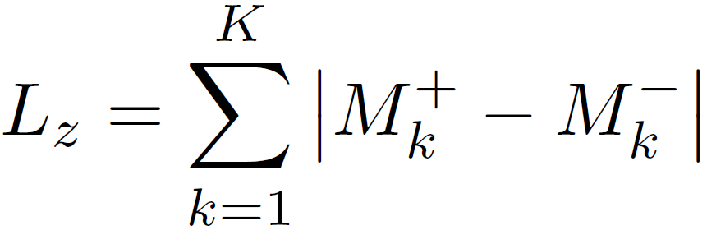
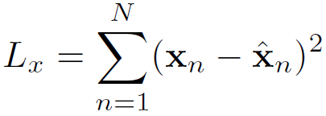
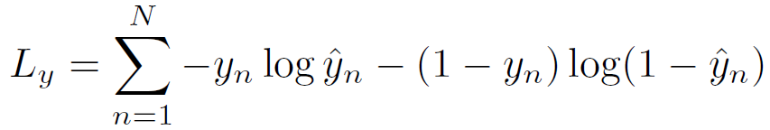

Loss function:
where:
Group fairness
Reconstruction error
Cross entropy
are hyper-parameters.

Slide 10
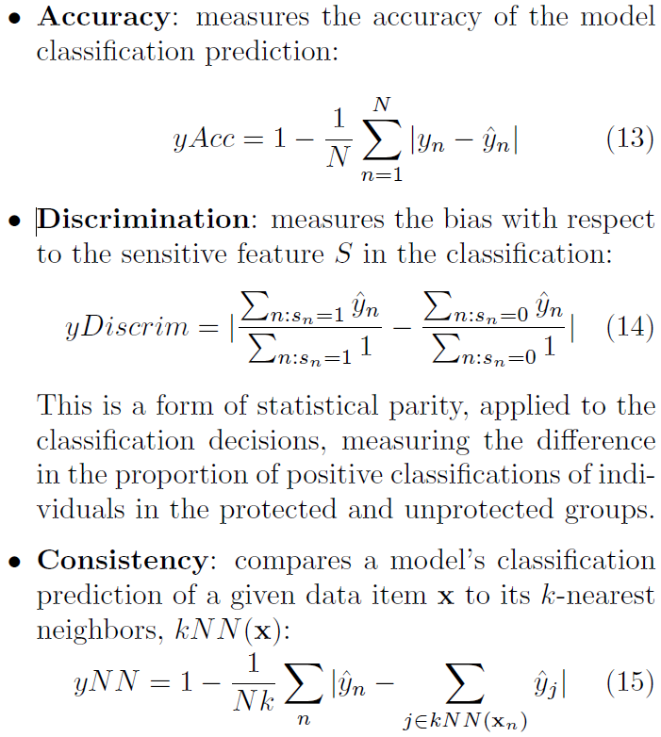
Metrics:
Group fairness
Individual fairness

